Slide 1


Slide 2

Overview
Introduction
Challenge
Solution
Implementation

Slide 3


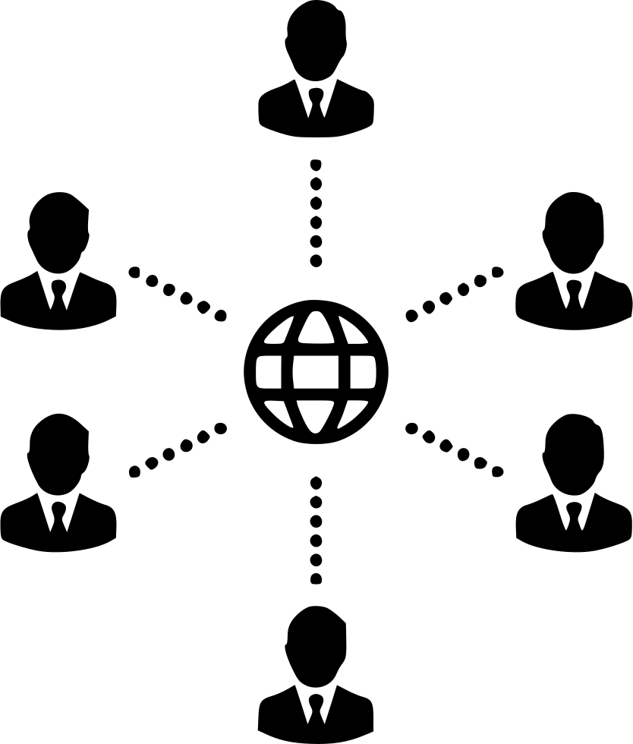
challenge
Empowering People
Disability
Inclusive Technology

Slide 4




Solution
Text Summary
Text to Speech
Image Describer
Object Identifier

Slide 5




Implementation
NodeJS
React Native
Firebase
Android App

